Slide 1
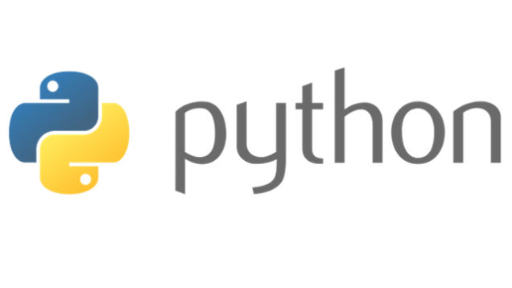
Dictionaries

Slide 2
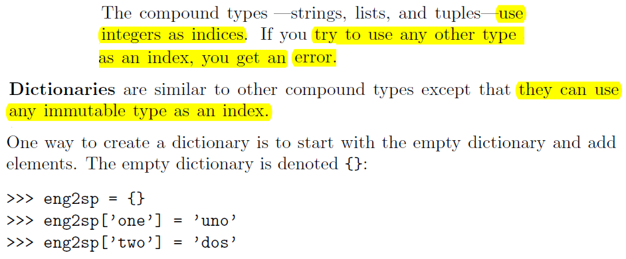

Slide 3
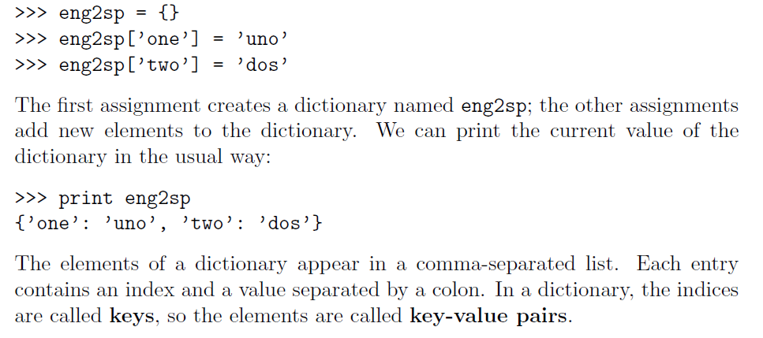

Slide 4
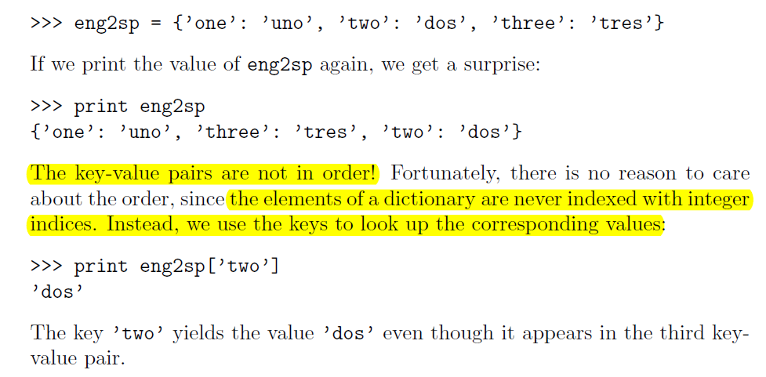

Slide 5

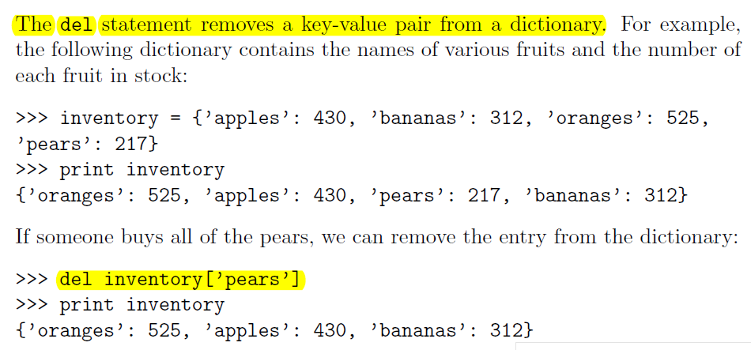

Slide 6
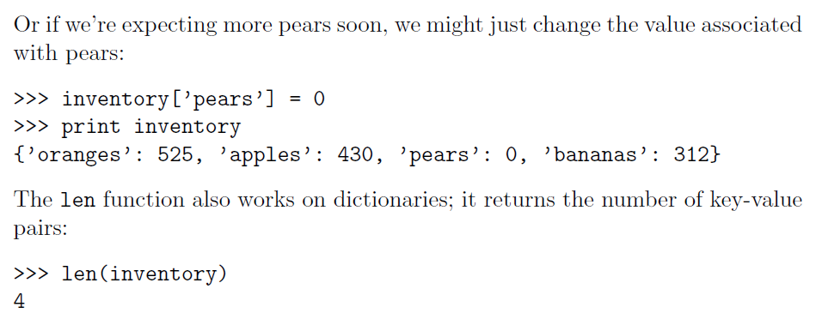

Slide 7

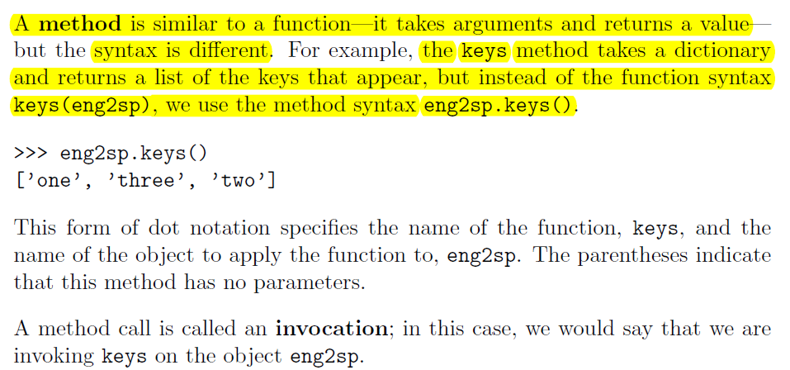

Slide 8
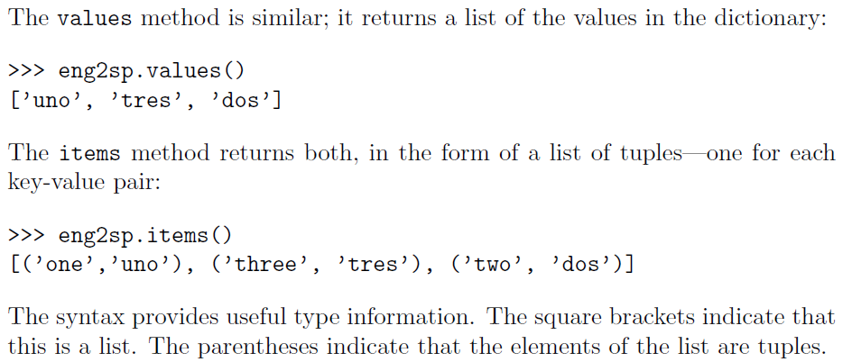
The syntax provides useful type information. The square brackets indicate that it’s a list. The parenthesis indicate that the elements in the list are tuples.

Slide 9

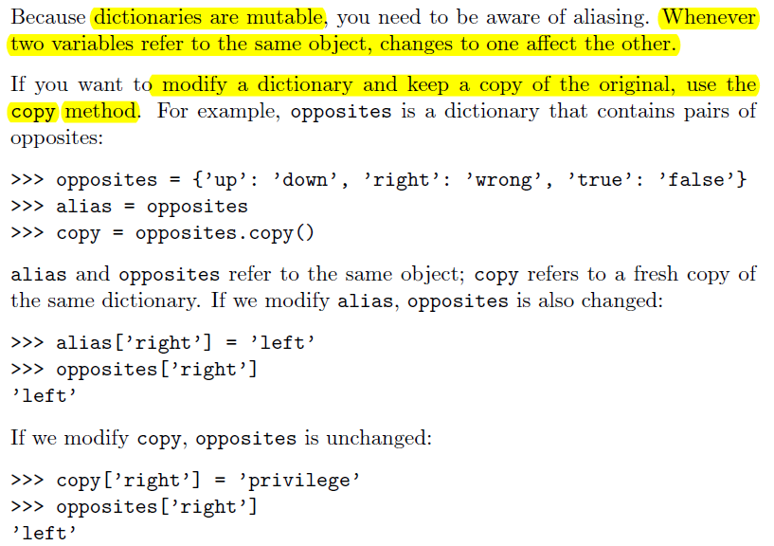

Slide 10

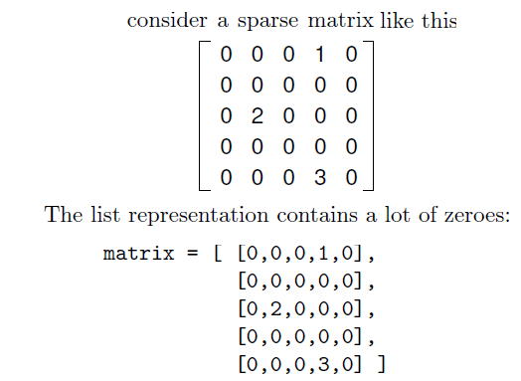
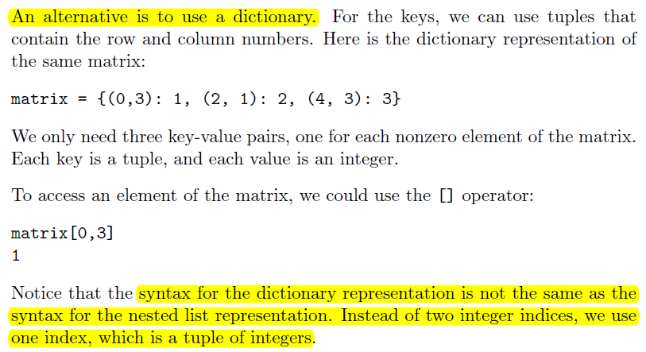

Slide 11
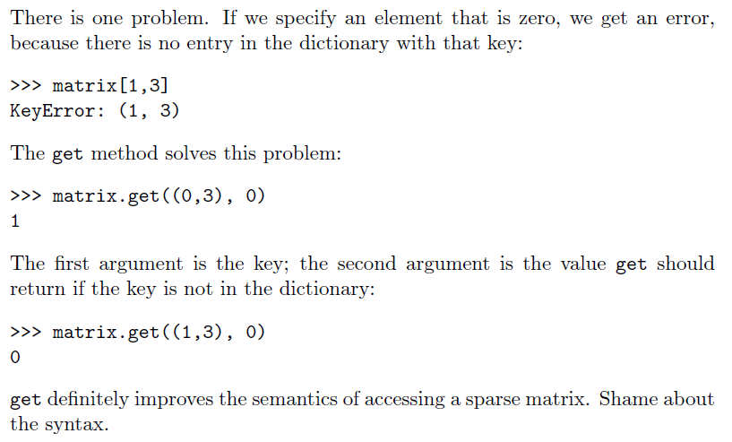

Slide 12

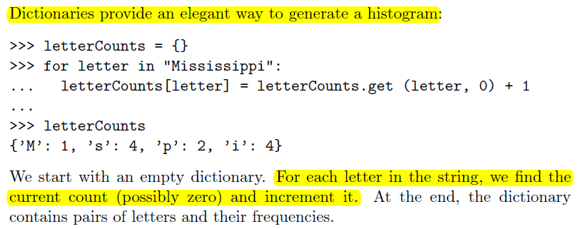

Slide 13
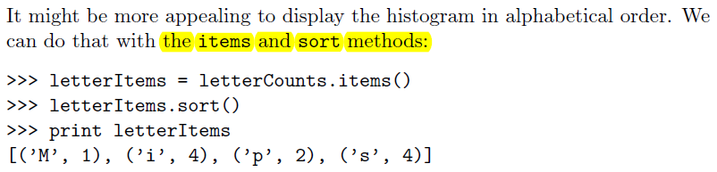

Slide 14
Iterate over Python dictionaries using for loops
d={'red':1,'green':2,'blue':3}
for color_key, value in d.items():
print(color_key,'corresponds to', d[color_key])
OUTPUT:
blue corresponds to 3
green corresponds to 2
red corresponds to 1
Remove a key from a Python dictionary
myDict = {'a':1,'b':2,'c':3,'d':4}
print(myDict)
if 'a' in myDict:
del myDict['a']
print(myDict)

Slide 15
OUTPUT:
{'d': 4, 'a': 1, 'b': 2, 'c': 3}
{'d': 4, 'b': 2, 'c': 3}
Sort a Python dictionary by key
color_dict = {'red':'#FF0000',
'green':'#008000',
'black':'#000000',
'white':'#FFFFFF'}
for key in sorted(color_dict):
print("%s: %s" % (key, color_dict[key]))
OUTPUT:
black: #000000
green: #008000
red: #FF0000
white: #FFFFFF

Slide 16
Find the maximum and minimum value of a Python dictionary
my_dict = {'x':500, 'y':5874, 'z': 560}
key_max = max(my_dict.keys(), key=(lambda k: my_dict[k]))
key_min = min(my_dict.keys(), key=(lambda k: my_dict[k]))
print('Maximum Value: ',my_dict[key_max])
print('Minimum Value: ',my_dict[key_min])
OUTPUT:
Maximum Value: 5874
Minimum Value: 500

Slide 17
Concatenate two Python dictionaries into a new one
dic1={1:10, 2:20}
dic2={3:30, 4:40}
dic3={5:50,6:60}
dic4 = {}
for d in (dic1, dic2, dic3): dic4.update(d)
print(dic4)
OUTPUT:
{1: 10, 2: 20, 3: 30, 4: 40, 5: 50, 6: 60}
Test whether a Python dictionary contains a specific key
fruits = {}
fruits["apple"] = 1
fruits["mango"] = 2
fruits["banana"] = 4

Slide 18
if "mango" in fruits:
print("Has mango")
else:
print("No mango")
if "orange" in fruits:
print("Has orange")
else:
print("No orange")
OUTPUT:
Has mango
No orange

Slide 19
QUESTIONS
Q1:Write a Python script to add a key to a dictionary.
Sample Dictionary : {0: 10, 1: 20}
Expected Result : {0: 10, 1: 20, 2: 30}
Q2: Write a Python script to concatenate following dictionaries to create a new one.
Sample Dictionary :
dic1={1:10, 2:20}
dic2={3:30, 4:40}
dic3={5:50,6:60}
Expected Result : {1: 10, 2: 20, 3: 30, 4: 40, 5: 50, 6: 60}
Q3: Write a Python script to check if a given key already exists in a dictionary.
Q4: Write a Python script to print a dictionary where the keys are numbers between 1 and 15 (both included) and the values are square of keys.
Sample Dictionary
{1: 1, 2: 4, 3: 9, 4: 16, 5: 25, 6: 36, 7: 49, 8: 64, 9: 81, 10: 100, 11: 121, 12: 144, 13: 169, 14: 196, 15: 225}

Slide 20
Q6: Write a Python script to merge two Python dictionaries.
Q7: Write a Python program to sum all the items in a dictionary.
Q8: Write a Python program to multiply all the items in a dictionary.
Q9: Write a Python program to remove a key from a dictionary.
Q10: Write a Python program to remove duplicates from Dictionary.
Q11: Write a Python program to create and display all combinations of letters, selecting each letter from a different key in a dictionary.
Sample data : {'1':['a','b'], '2':['c','d']}
Expected Output:
ac
ad
bc
bd

